Slide 1
2026
July
by SlideX
Project Name
Moodboard

Slide 2
2026
July
by SlideX
Project Name
Moodboard

Slide 3

2026
July
by SlideX
Project Name
Moodboard

Slide 4
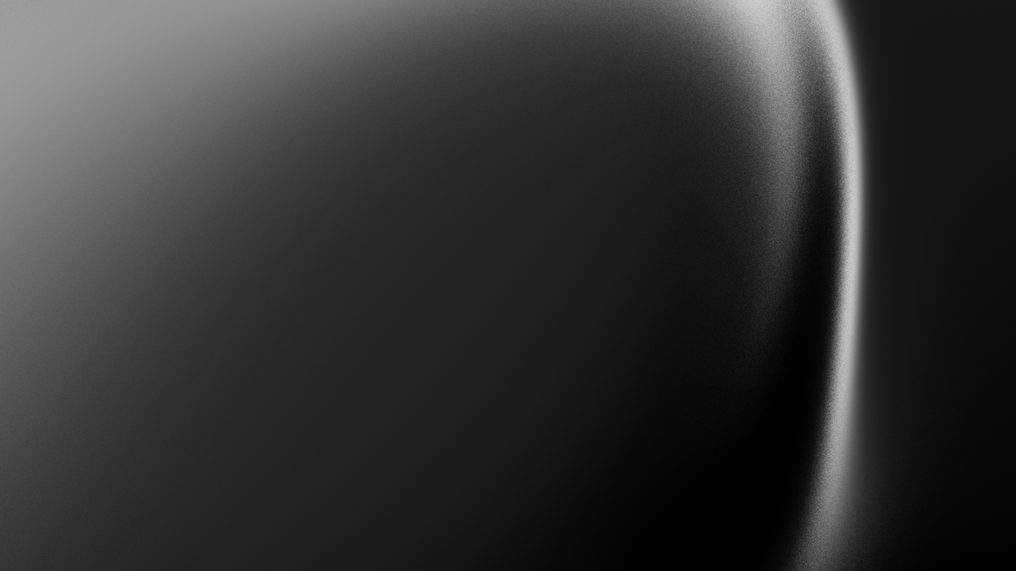
2026
July
by SlideX
Project Name
Moodboard

Slide 5
Background
Context
This moodboard explores a modern visual direction that balances simplicity, warmth, and bold expression. Through clean typography, soft color palettes, natural textures, and structured layouts, the design creates an atmosphere that feels contemporary, approachable, and memorable.
2026
July
by SlideX

Slide 6
Designing the Future
A visual exploration of color, typography, texture, and composition, created to define a modern, expressive, and memorable design direction.

Slide 7
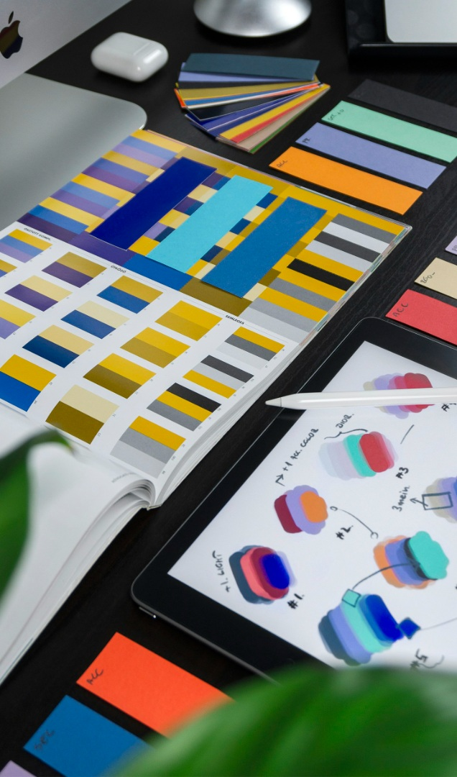
Beyond the Ordinary
A curated collection of visual references exploring bold ideas, refined details, and unexpected combinations to shape a distinctive creative direction.

Slide 8
01
Typography

Slide 9
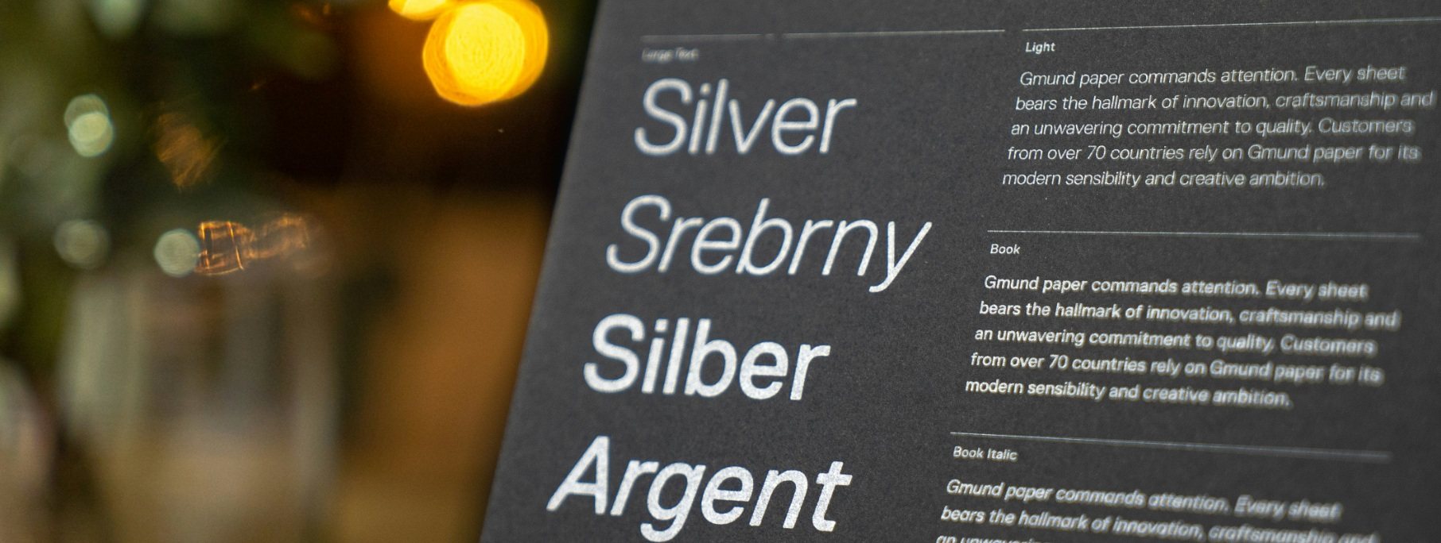
Typography shapes how a message feels and flows.

Slide 10
02
Animations

Slide 11
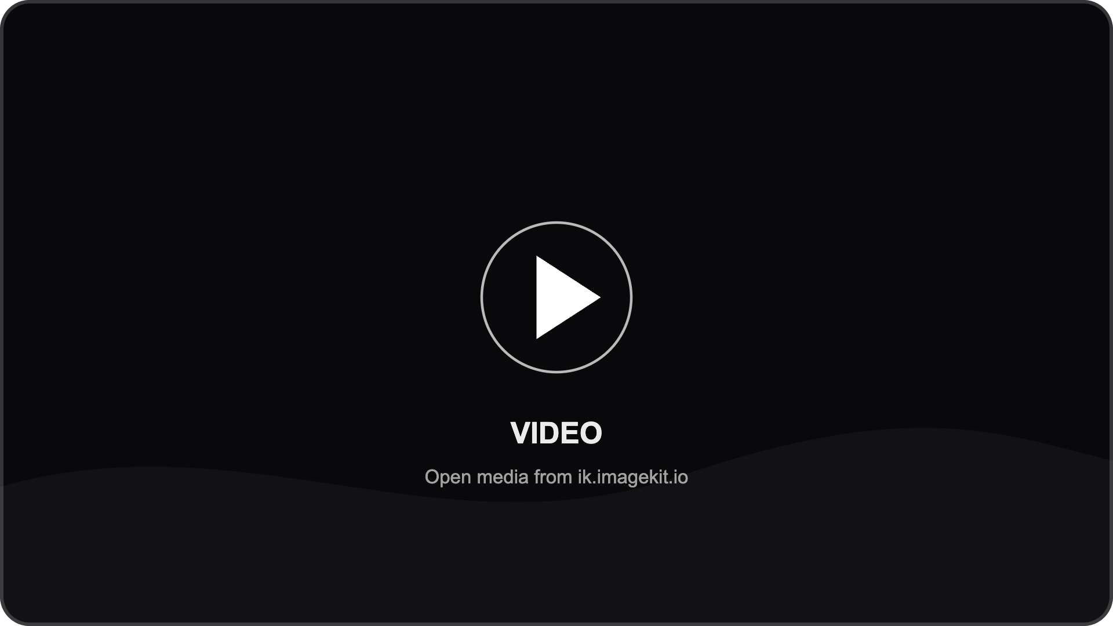

Slide 12
03
Textures

Slide 13
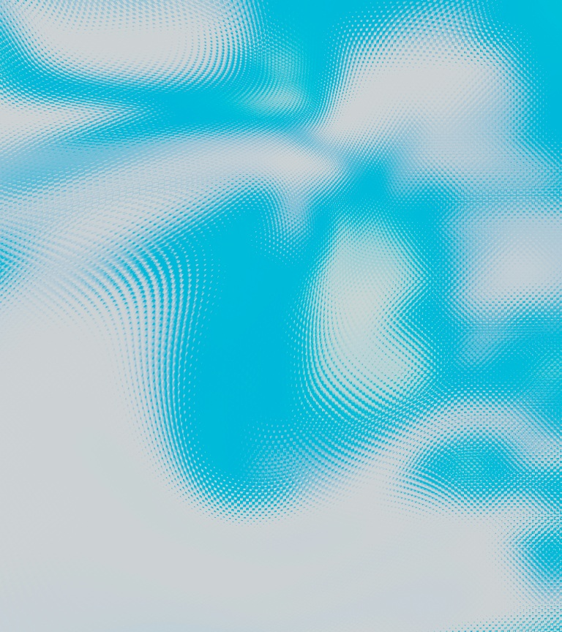
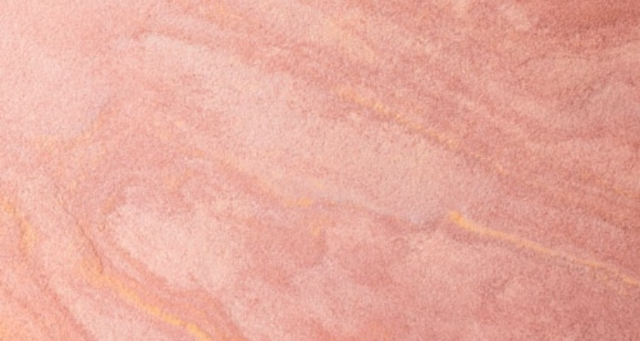
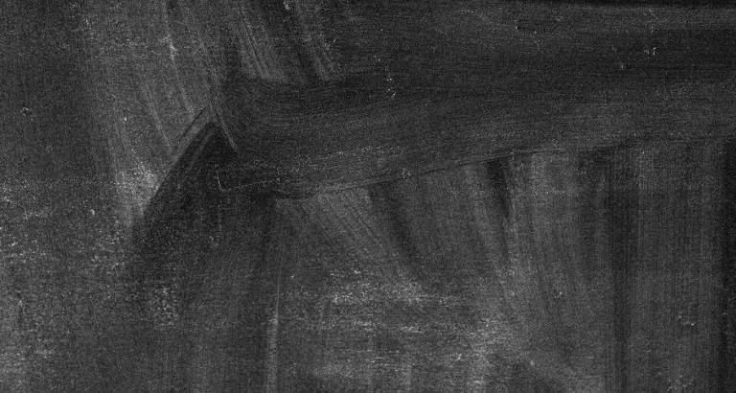

Slide 14
2026
July
by SlideX
Hello@gmail.com

