Slide 1
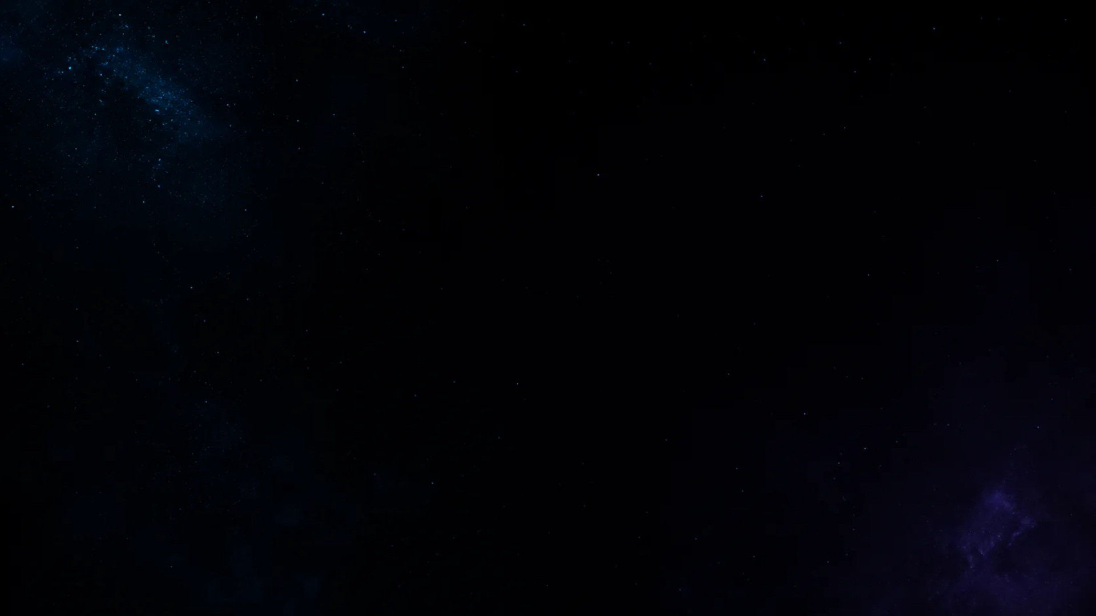
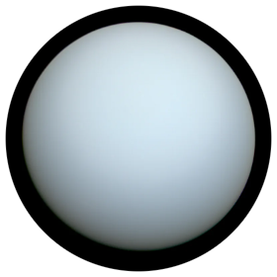
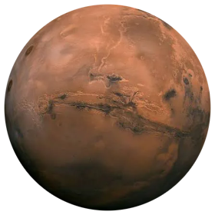
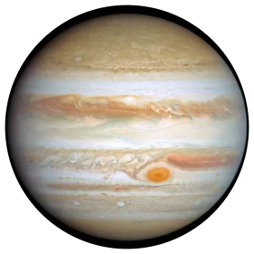
Uranus
Mars
Jupiter

Slide 2

Uranus
Uranus is the seventh planet from the Sun, known for its blue-green color, icy atmosphere, and unique sideways rotation.

Slide 3

Mars
Mars is the fourth planet from the Sun, known for its red surface, cold climate, and the possibility that it once had liquid water.

Slide 4

Jupiter
Jupiter is the largest planet in the Solar System, known for its Great Red Spot, powerful storms, and many moons.

